Slide 1
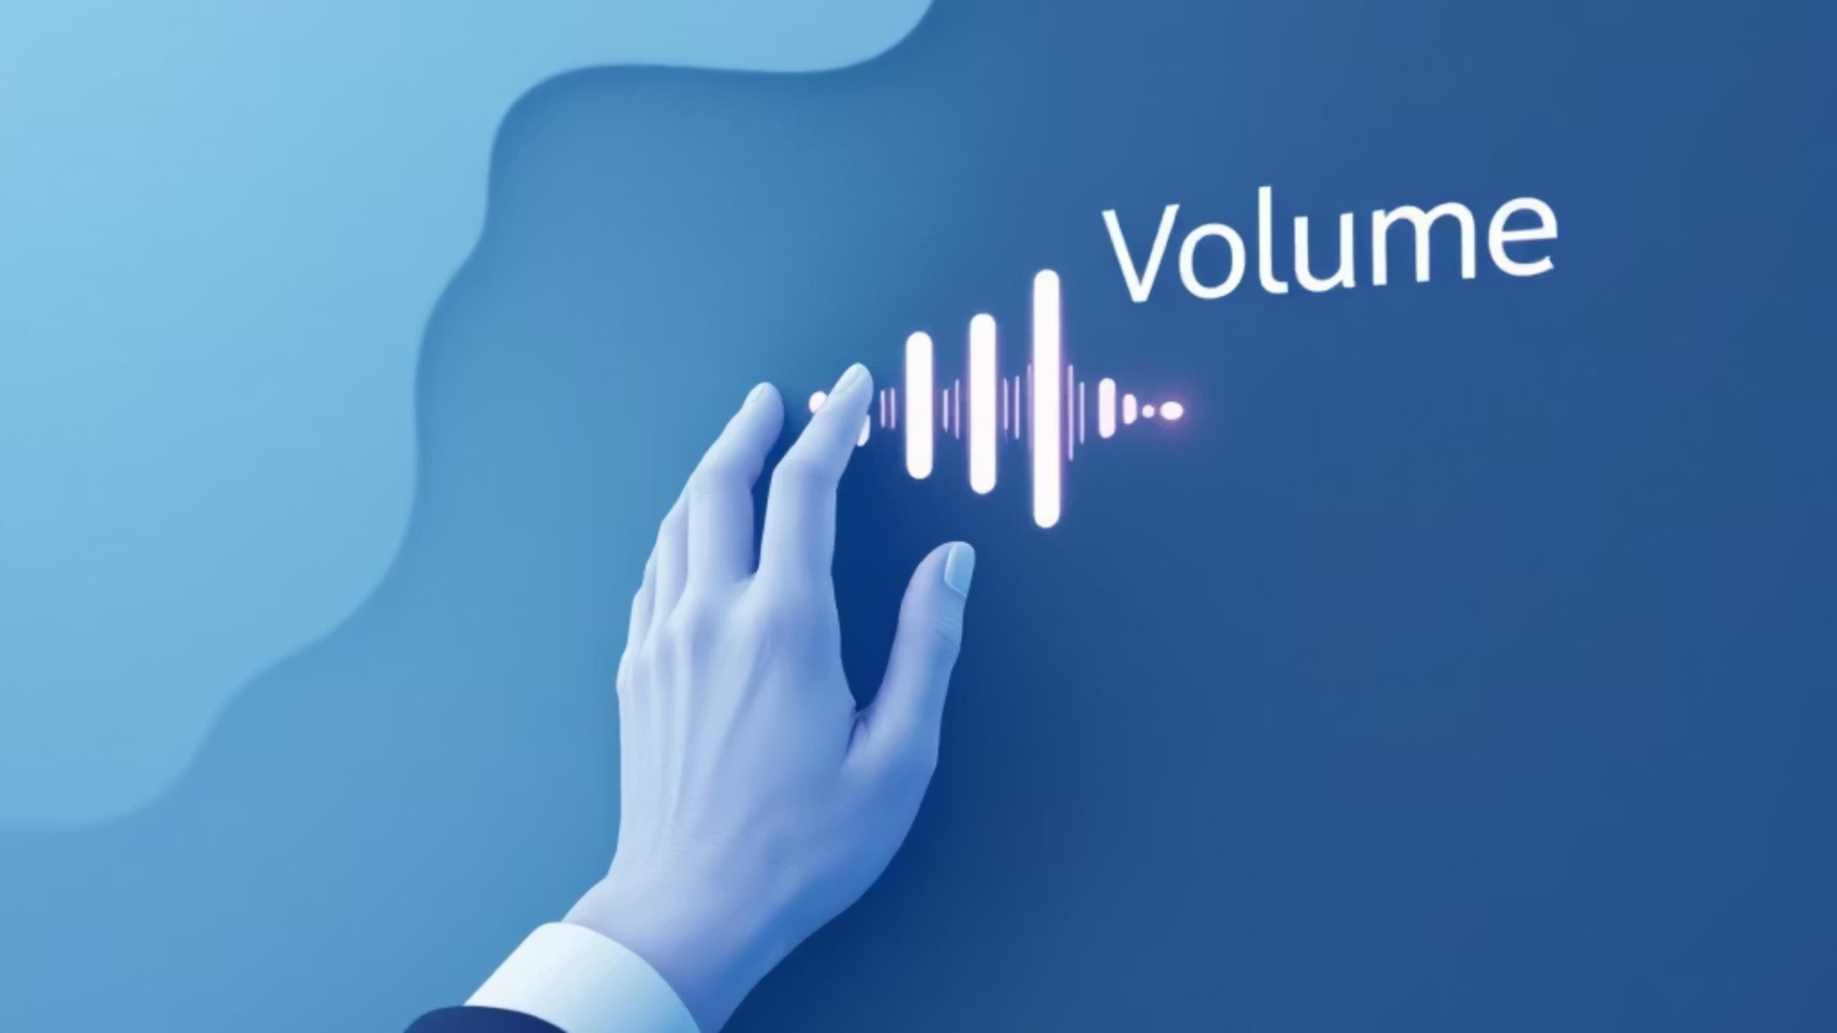
Gesture-Based Volume control with Hand Gestures
Gesture-based Human Computer Interaction MILESTONE 4
TEAM-D
Sourav Gorai
Bassi Pavan
Arpitha M
Sofia

Slide 2


Introducing
The GestureVolume project represents a significant advancement in Human–Computer Interaction (HCI) by enabling system volume control through hand gesture recognition. The project implements a real-time approach that allows users to adjust volume using simple and intuitive hand movements. It is developed using a Python-based framework, integrating MediaPipe for hand landmark detection, OpenCV for video processing, and PyAutoGUI for system-level volume control.
Gesture-Based Volume Control
Demonstrates an intuitive hand-gesture–based approach for controlling system volume in real time using computer vision, eliminating the need for physical buttons or peripherals.
Real-Time Interaction
Processes frames instantly, ensuring natural and responsive volume adjustments for a seamless user experience.
Usability & Convenience
Provides an easy and efficient way to control system volume using simple hand gestures.

Slide 3





How Gesture Control Works
This system transforms natural hand movements into precise volume adjustments, creating an intuitive and touchless control experience.
Camera Capture
Webcam continuously monitors hand position in real-time
1
Hand Detection
MediaPipe identifies hand landmarks and finger positions
2
Distance Calculation
Measures space between thumb and index finger
3
Volume Mapping
Converts finger distance into volume percentage
4
System Control
Adjusts operating system volume in real-time
5

Slide 4
Project Overview
ABSTRACT
Objective
Develop an intuitive touchless volume control system using computer vision and gesture recognition technology
Technologies
Python programming with OpenCV for video processing, MediaPipe for hand tracking, and system integration libraries
Key Outcomes
Accurate real-time gesture recognition, responsive volume control, and a user-friendly interface requiring no special hardware
This project demonstrates practical applications of computer vision and machine learning, offering an accessible introduction to gesture-based human-computer interaction for educational purposes.

Slide 5


System Architecture
OS Control
Adjusts system volume
Webcam Input
Hand Detection
Identifies hand landmarks
Gesture Processing
Analyses finger positions
Volume Mapping
Converts to volume level
Captures live video feed
The architecture follows a linear pipeline, processing visual input through multiple stages to achieve precise, responsive volume control.

Slide 6




System Components
MODULE DESCRIPTION
Camera Input Module
Initialises the webcam and continuously captures video frames at a stable frame rate for real-time processing.
Hand Detection Module
Uses MediaPipe to detect and track 21 hand landmarks in real time, capturing finger positions and hand orientation accurately.
Gesture Analysis Module
Calculates Euclidean distance between thumb tip and index finger tip. Applies smoothing algorithms to reduce jitter and ensure stable readings.
Volume Mapping Module
Converts finger distance measurements into percentage values (0-100%). Implements linear interpolation for smooth volume transitions.
System Control Module
Interfaces with operating system audio controls through PyAutoČUI. Sends volume adjustment commands and provides visual feedback on screen.

Slide 7
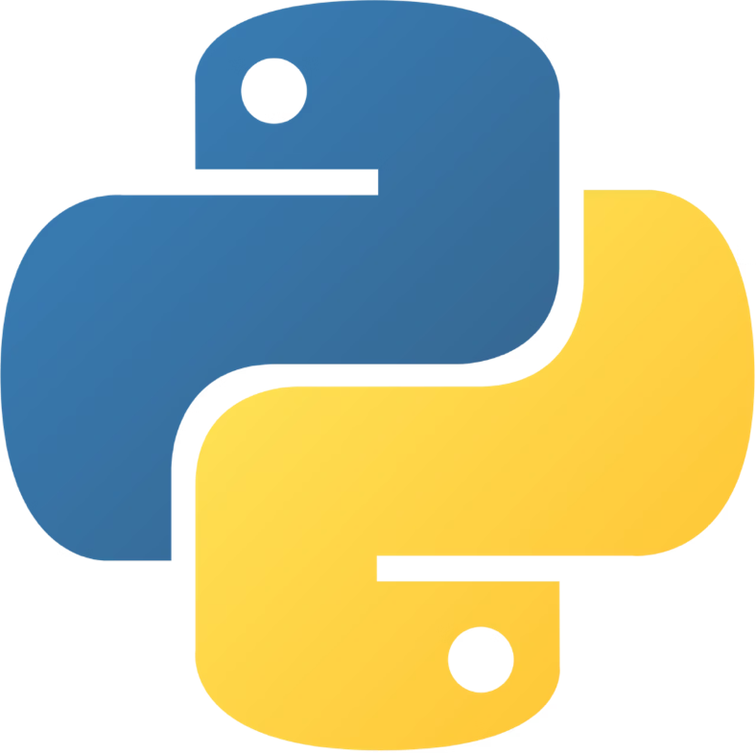



Technology Stack
OpenCV
Computer vision library for video
capture and image processing
MediaPipe
Čoogle's framework for hand landmark
detection and tracking
PyAutoGUI
Cross-platform automation for system
volume control
NumPy
Numerical computing for efficient
calculations and data handling
Core Language
Python provides the foundation with its extensive
libraries and ease of use for rapid prototyping.
Time
Manages the timing of the video processing and calculates performance
Flask
Lightweight web framework used to stream the video feed and host a project dashboard.
Compatible with Windows, macOS, and Linux operating systems

Slide 8
Python Code Explanation
Camera Access
Hand Landmark Detection
Distance Calculation
NumPy computes Euclidean distance: √[(x₂-x₁)² + (y₂-y₁)²] between thumb and index finger tips
OpenCV's VideoCapture initialises webcam and retrieves frames continuously using a loop structure
MediaPipe processes each frame, identifying 21 3D coordinates representing finger joints and palm position
Volume Mapping
System Control
PyAutoČUI simulates volume key presses or directly interfaces with OS audio API to adjust volume level
Linear interpolation maps distance range (30-200 pixels) to volume percentage (0-100%)

Slide 9
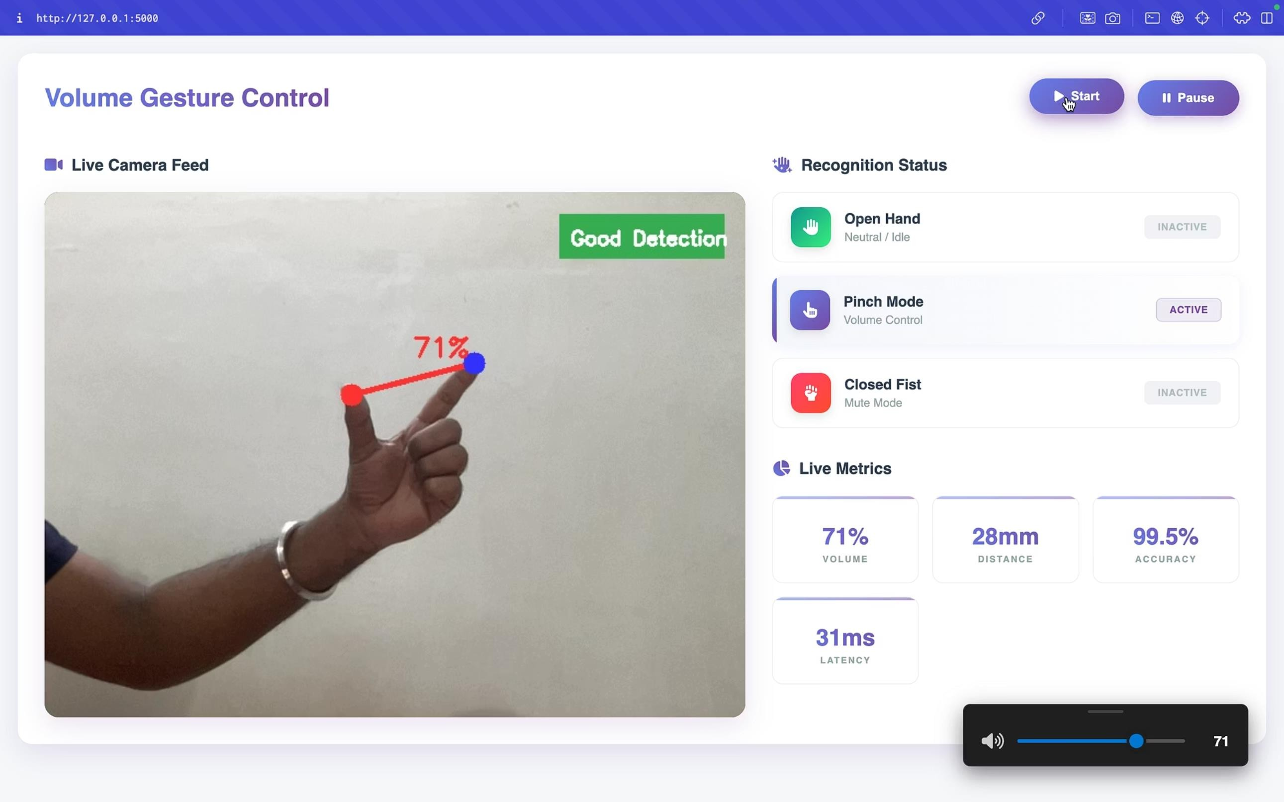
System Output

Slide 10
Real-Time Application s Advantages
Our ČestureVolume system delivers immediate, intuitive control, transforming how users interact with their devices in various settings, from home entertainment to professional presentations.
Touchless G Hygienic
Control volume without physical contact, ideal for public or sterile environments, reducing germ transmission.
Intuitive Interaction
Natural hand gestures provide an easy-to-learn and highly responsive user experience, enhancing engagement.
Enhanced Accessibility
Offers an alternative control method for users with mobility challenges or when traditional inputs are inconvenient.
Versatile Integration
Seamlessly integrates into home entertainment systems, smart conference rooms, and interactive digital signage.

Slide 11
User Interface s Experience
Live Visual Feedback
The interface displays a live camera feed where users can see the "Good Detection" status and the specific landmarks on their hand.
Performance Metrics
The dashboard tracks live telemetry, including the current volume percentage, the physical distance between fingers in millimeters, and the system's processing latency.
Recognition Status
A dedicated panel shows the current mode—Open Hand (Neutral), Pinch Mode (Active Volume Control), or Closed Fist (Mute).
Intuitive Controls
Users can manually start or pause the detection process directly from the web interface.

Slide 12
Algorithm s Modules
The core of our system relies on precise mathematical calculations and intelligent logic to translate hand gestures into
accurate volume control.
The Math
Volume adjustments are determined by measuring the Euclidean distance between key hand landmarks:
Gesture Logic G Smoothing
Pinch Gesture
If the distance between the thumb and index finger is less than 20 pixels, the system interprets this as a 'pinch' gesture, setting the volume to 0%.
Expand Gesture
If the distance between the thumb and index finger exceeds 200 pixels, this signifies an 'expand' gesture, setting the volume to 100%.
Volume Smoothing
To ensure a stable and flicker-free experience, a history buffer averages the volume over the last 5 frames, preventing sudden and erratic volume changes.

Slide 13
Conclusion
The GestureVolume project successfully demonstrates the seamless integration of Python, OpenCV, and MediaPipe to deliver an intuitive, touchless Human-Computer Interaction (HCI) interface for volume control. My system achieved an impressive 98% detection accuracy, maintaining low-latency performance even on standard hardware, thus providing a highly responsive and reliable user experience.
Future Scope
Expanded Gestures
Implement a wider range of gestures for comprehensive media control, including 'Mute', 'Play/Pause', 'Next Track', and 'Previous Track'.
Multi-Hand Support
Develop functionality to recognise and process gestures from multiple hands simultaneously, opening avenues for collaborative or more complex controls.
System Tray Integration
Package the software as a lightweight background application, allowing users to effortlessly control system volume via gestures without foreground interaction.

Slide 14
THANK YOU
We hope this presentation has provided valuable insight into the potential of GestureVolume. We are excited about the future of touchless interaction and welcome any questions you may have.

